Slide 1

Flight Ticket Booking (FTB)
Team 6:
Chibuisi Kelvin Amiaka
Ali Mohammad Ahmadi
Aug 2019

Slide 2
Problem Statement
Aero Travels is an airline reservation company. It has numbers of branches spread across the world. The Aero Travels manages flight operations manually, but as its customers grow in number, managing flight operations manually becomes difficult and time consuming. So, it would be better to use an automated system.

Slide 3

Users
FTB System Functionalities
Schedule Flights
Book Flights
Search Available Flights
Verify Booking
Admin
Travel Agent
Customer

Slide 4
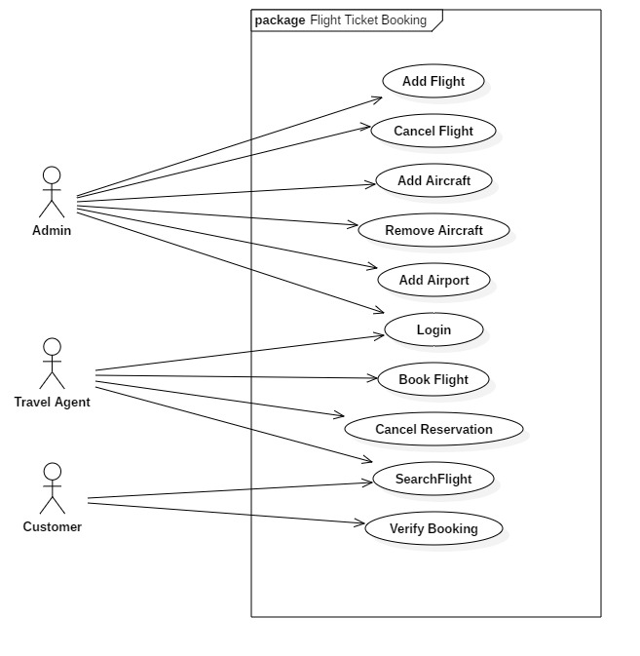
Use Case Diagram

Slide 5
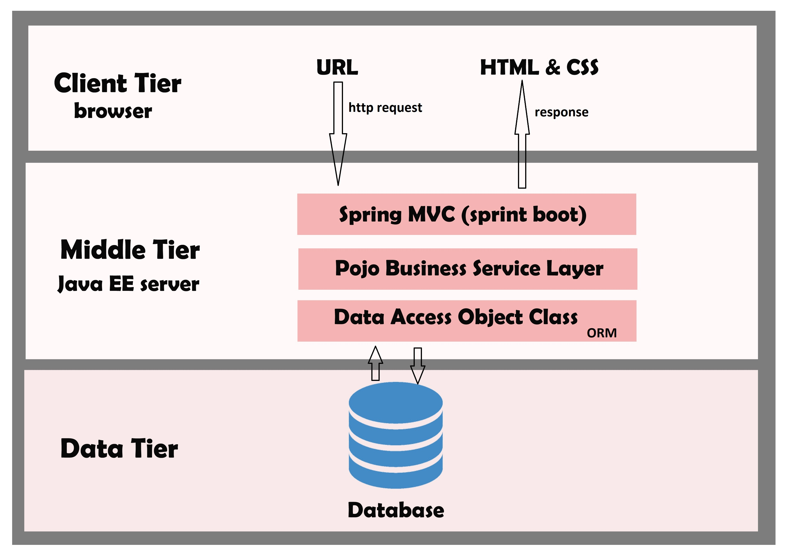
System Architecture

Slide 6
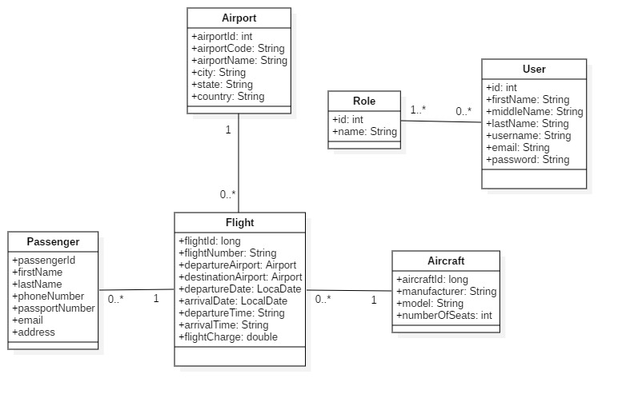
Class Diagram

Slide 7
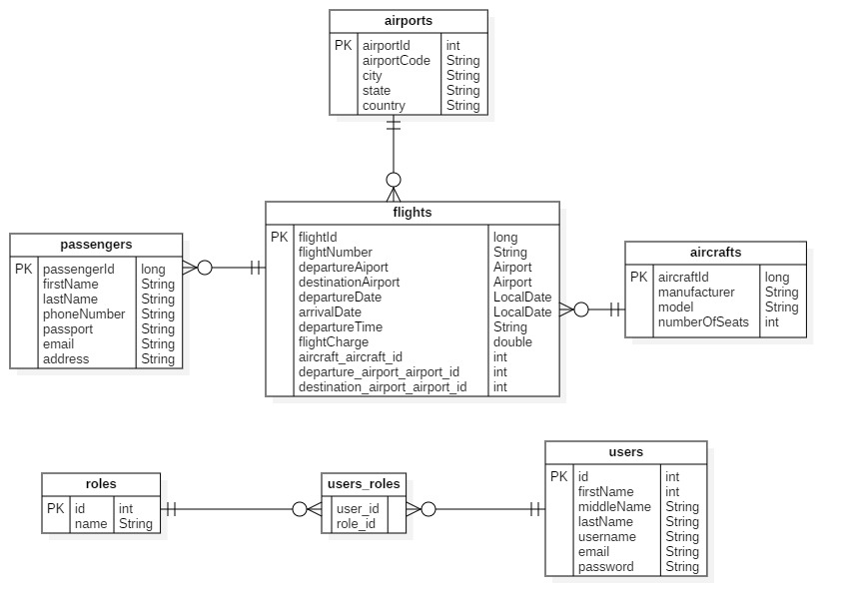
ER Diagram

Slide 8
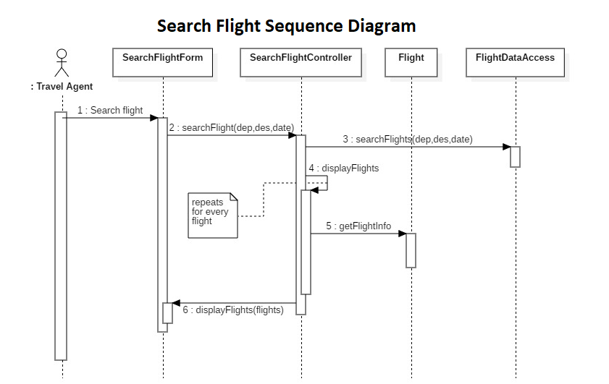
Sequence
Diagram for
Search
Flight

Slide 9
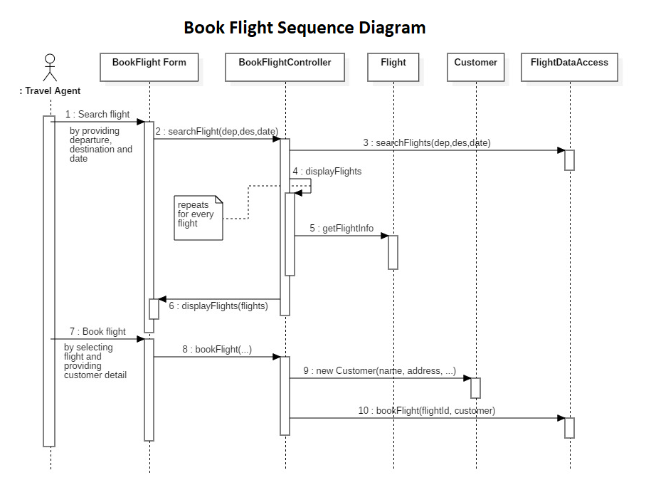
Sequence
Diagram for
Book Flight

Slide 10
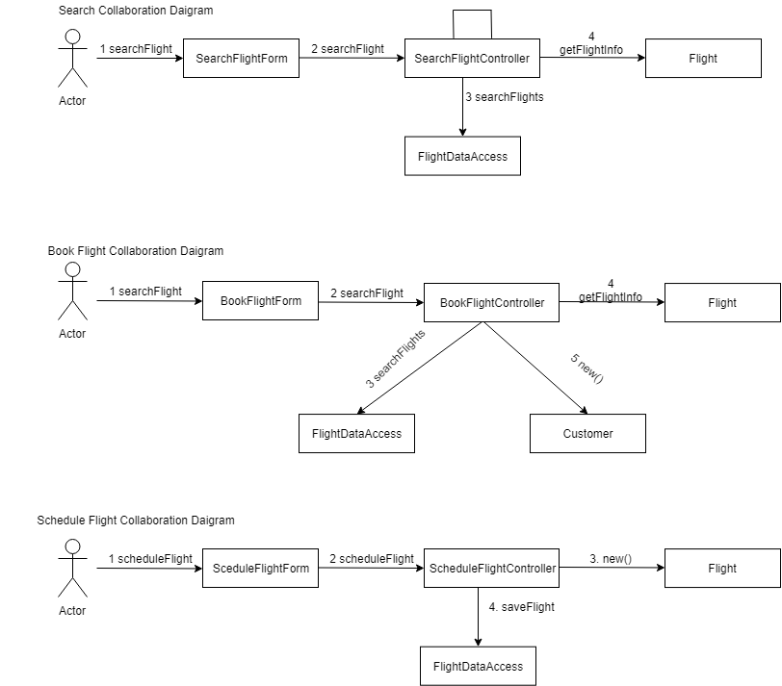
Collaboration
Diagram

Slide 11

THANK YOU!

